Slide 1
Software Engineering in R
Presentation to Chicago R Users Group
Tips for making R more developer-friendly
Eric Knell

Slide 2
R as a development platform
Strengths
Extensive library support
Interactive development environment (RStudio, StatET)
Data structures well-designed for quantitative analysis (data frame, zoo, etc.)
Easy to learn basic functionality
Weaknesses
Hard to debug
Combination of dynamic typing and lazy evaluation
Terse error messages (“attempt to apply non-function”)
Fractured object model (S3, S4, …)
Performance issues with some types of operations
Single-threaded

Slide 3
Type-checked Methods
Motivation
Many bugs caused by type errors
Failures often occur deep in the stack, far from the initial error
Type-checking also serves as a living documentation
Custom, proprietary code, but open-source implementation possible
Example Usage
function(seriesNames, sourceNames) {
needs(seriesNames="character|list(character)", sourceNames="character|list(character)")
…
}
function(axis1Names, axis2Names, fileNameExtension = NULL, aggFunction = mean) {
needs(axis1Names='character', axis2Names='character', aggFunction='function', fileNameExtension='character?‘)
…
}

Slide 4

Unit Testing
RUnit
Unit testing in the style of JUnit
Continuous integration
Examples
testInit <- function() {
conn <- SQLConnection()
checkTrue(!conn$isConnected())
conn$init()
checkTrue(conn$isConnected())
}
testSelect <- function() {
conn <- SQLConnection()
conn$init()
query.results = conn$select("SELECT 1 + 1 FROM METADB_SYMBOLS")
checkTrue(is.data.frame(query.results))
checkTrue(length(query.results) == 1)
checkTrue(all(query.results[,1] == 2))
}

Slide 5
Continuous Integration
Developer
Write Code
Run Tests
Commit to Source Control
Continuous Integration Server
Source Control
Update
Build
Run Tests

Slide 6
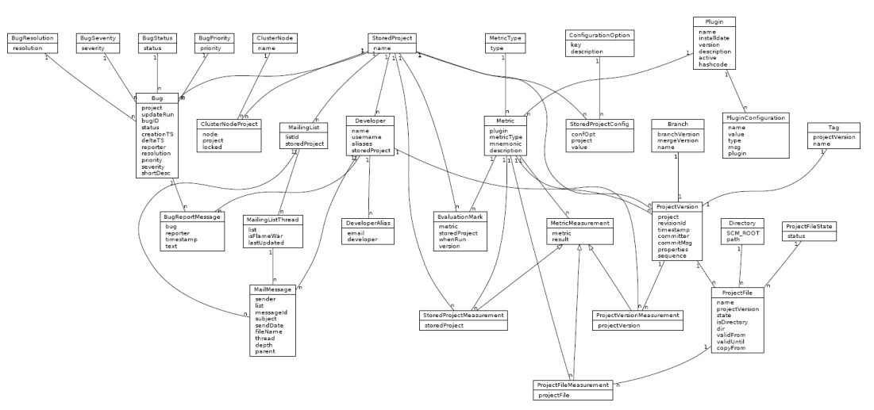
Object-Oriented with R.oo
Sits on top of S3 and provides a simple interface for defining classes and methods, automatically creating S3 generic functions as needed
Semantics familiar to Java programmers
Precursor to reference objects
Top-level Object wraps environment to provide easy pass-by-reference

Slide 7
Java Integration
Why integrate with Java?
Large library of domain objects
Large library of utility classes
Don’t want to reinvent the wheel. If I have Java code that reads a bunch of data from a database, I don’t want to rewrite that.
rJava is great, but very low level – too much boilerplate
Reflection-based interfaces too slow to use at run-time
Java Reflection is an API for querying the Java runtime for information about class/method signatures

Slide 8
Java Integration
Solution: Use Reflection at compile-time to auto-generate the boilerplate
Create R.oo classes for each Java class that we wrap
All rJava casts/etc. done for you by the wrapper
setConstructorS3("JTsdb", function(jobj = NULL) {
extend(JObject(), "JTsdb", .jobj = jobj)
})
setMethodS3("series_by_String", "JTsdb", function(static, j_arg0 = NULL, ...) {
JTimeSeries(jobj = jCall("atg/dal/tsdb/Tsdb", "Latg/dal/tsdb/TimeSeries;", "series", the(j_arg0)))
})
setMethodS3("source_by_String", "JTsdb", function(static, j_arg0 = NULL, ...) {
JDataSource(jobj = jCall("atg/dal/tsdb/Tsdb", "Latg/dal/tsdb/DataSource;", "source", the(j_arg0)))
})
setConstructorS3("JTimeSeries", function(jobj = NULL) {
extend(JObject(), "JTimeSeries", .jobj = jobj)
})
setMethodS3("observations_by_DataSource", "JTimeSeries", function(this, j_arg0 = NULL, ...) {
JIterable(jobj = jCall(this$.jobj, "Lscala/collection/Iterable;", "observations", .jcast(j_arg0$.jobj, "atg.dal.tsdb.DataSource")))
})
Usage:
series <- JTsdb$series_by_String(“aapl close”)
source <- JTsdb$source_by_String(“yahoo”)
observations <- series$ observations_by_DataSource(source)

Slide 9
Python Integration
Using Python more and more for research “infrastructure”
Still want access to analytics from R
Use rpy2 to get “best of both worlds”
JVM (Java)
CLR (.NET)
IKVM
rJava
R
JCC
rpy2
Python

Slide 10

Questions?
Contact information:
Eric Knell
eric.knell@credit-suisse.com

